Slide 2
AI suggested tags

Slide 3
Choice of AI
Initial Choice
Google Gemini-2.0-flash provided via their free tier
Issue
Inaducate usage limit
Final Choice
Llama-3.3-70b-versatile provided by Groq. An API service providing access to various LLM models
Improvements
Increased usage limit
Wealth of choice(GPT-OSS, Mistral)

Slide 4
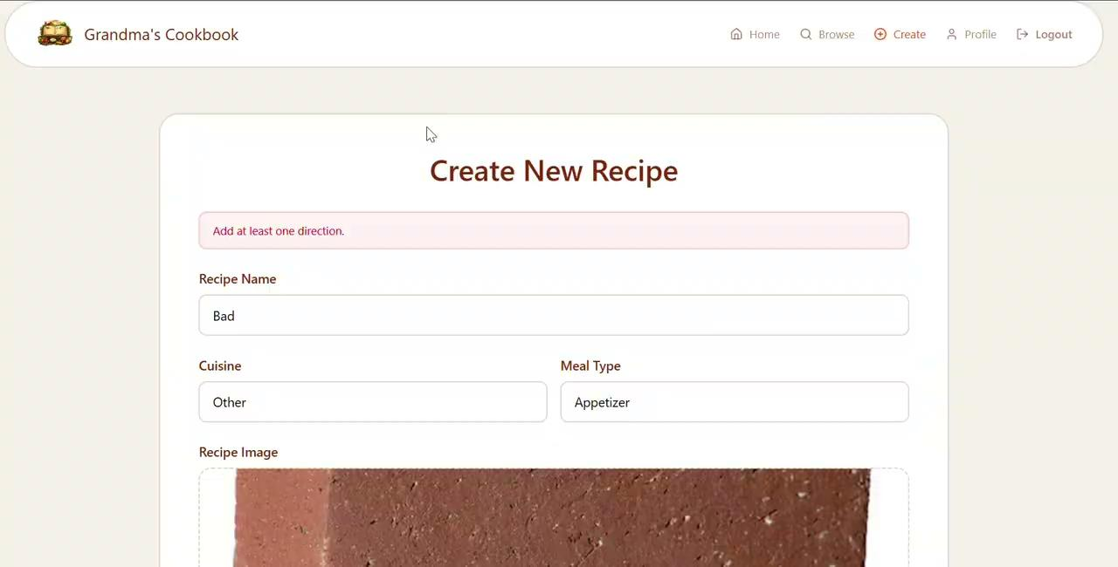
AI toggle
The AI feature can be used when updating or creating a recipe

Slide 5
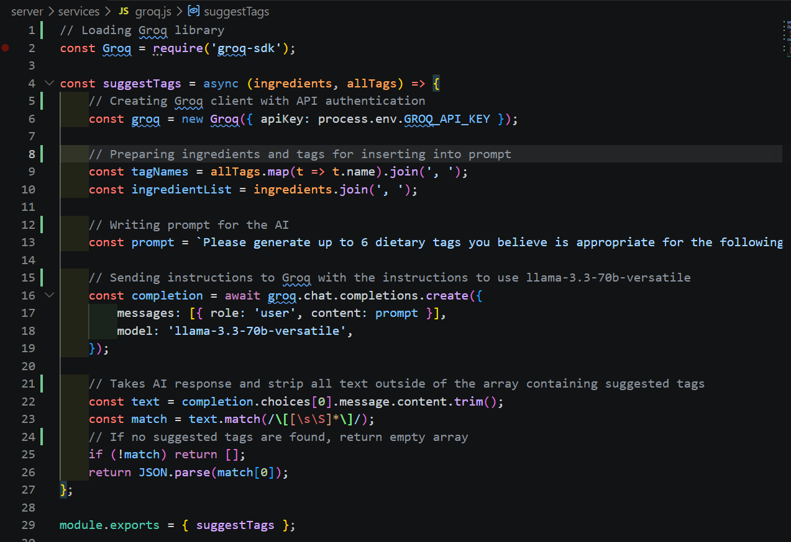
Created Service
Prompt used
Please generate up to 6 dietary tags you believe is appropriate for the following set of ingredients for a recipe. Keep the tags about 2 words in max length. You may generate new tags or use already existing tags when appropriate. Ingredients: ${ingredientList}, Available tags: ${tagNames}. Your return format must be just like this for backend processing: ["tag1", "tag2"].

Slide 6
Trace Through of Suggesting Tags
Router listens for /suggest-tags
Extracts ingredients and tags from the request object
Fetch all tags from database
Comparing the array of tags and removing selected items to prevent duplicates suggested, producing availableTags variable
Sending available tags and ingredients to AI service
Returns the new tags produced by AI and selected tags to be stored by recipe controller

Slide 7
Lessons Learned

Slide 8
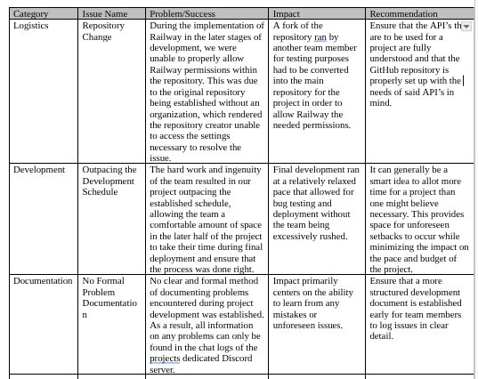

Slide 9
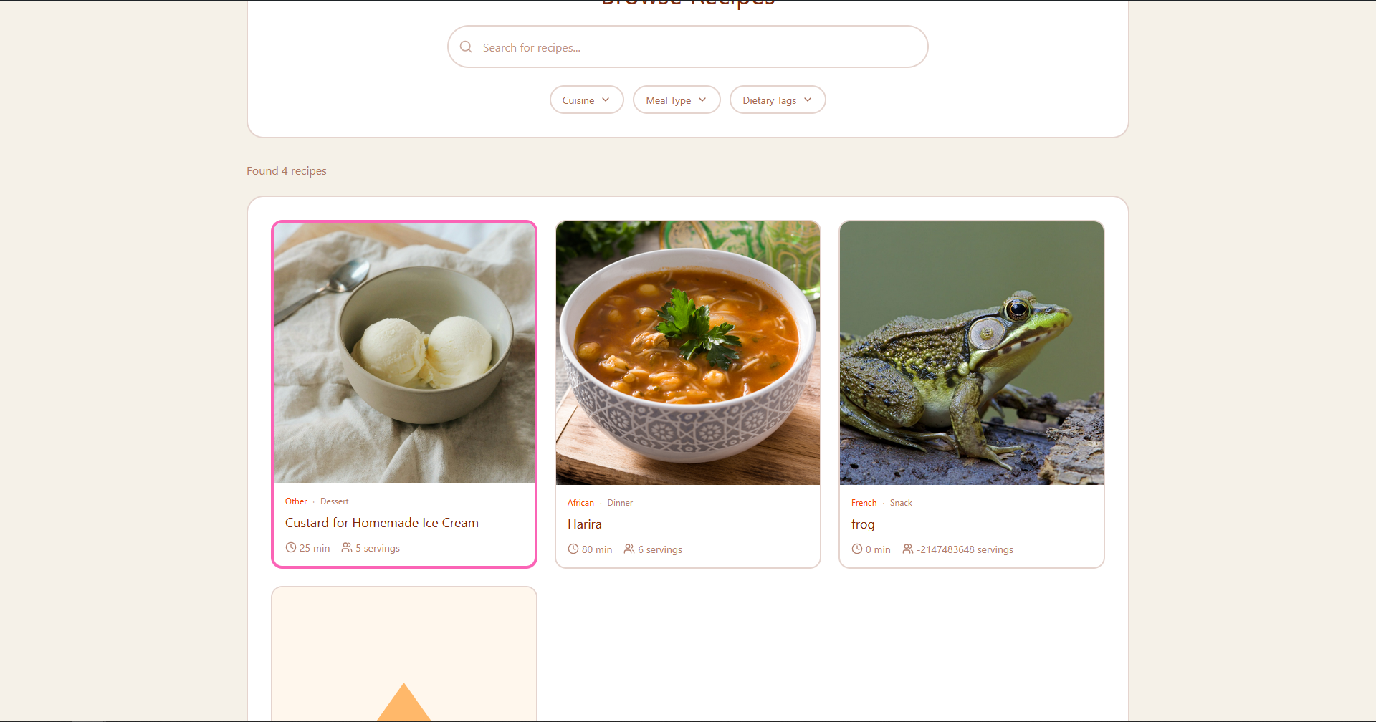
Recommended Recipes
Recipes made by the team are pushed to the front of the “browse” tab and highlighted in pink

Slide 10
Endnote
Grandma’s Cookbook has been a grand learning experience for the team at Grandma’s Recipe Co. and we hope that the following live demo will be an effective demonstration of what we’ve learned and how we’ve implemented it.

